Slide 1

Ajax and JQuery
Rajeev Gupta
Rgupta.mtech@gmail.com
Java Trainer & Consultant

Slide 2
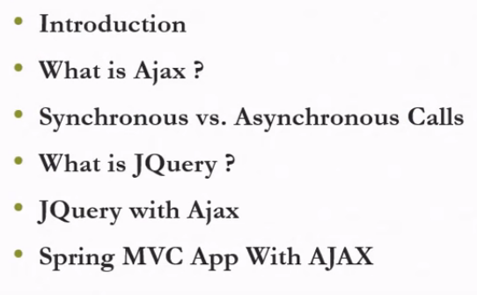
Agenda

Slide 3
What is Ajax?
●
Ajax can help increase the speed and usability of an application's web pages by updating only part of the page at a time, rather than requiring the entire page to be reloaded after a user-initiated change.
Using Ajax, the pages of your application can exchange small amounts of data with the server without going through a form submit.
AJAX is the art of exchanging data with the server and updating part of web pages- without reloading the whole page asynchronously
●
●

Slide 4
The Ajax Technique
 The Ajax technique accomplishes this by using the following technologies:
 JavaScript that allows for interaction with the browser and responding to events.
 DOM for accessing and manipulating the structure of the HTML of the page.
 XML which represents the data passed between the server and client.
 An XMLHttpRequest object for asynchronously exchanging the XML data between the client and the server.

Slide 5
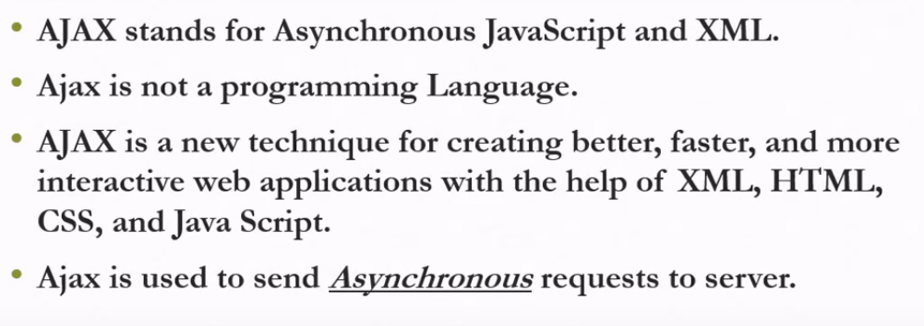
Introduction

Slide 6
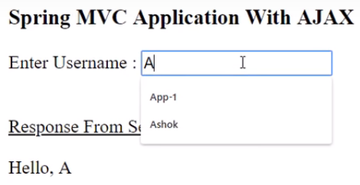
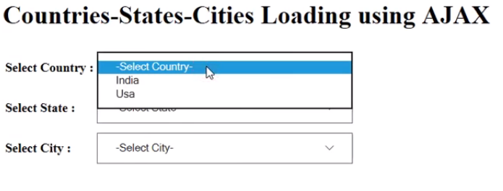
Ajax Applications

Slide 7
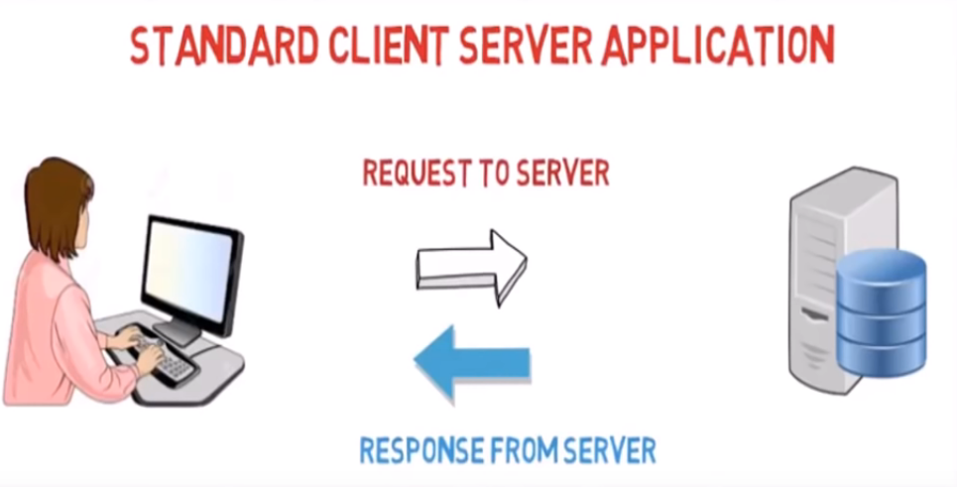
Client server communication

Slide 8
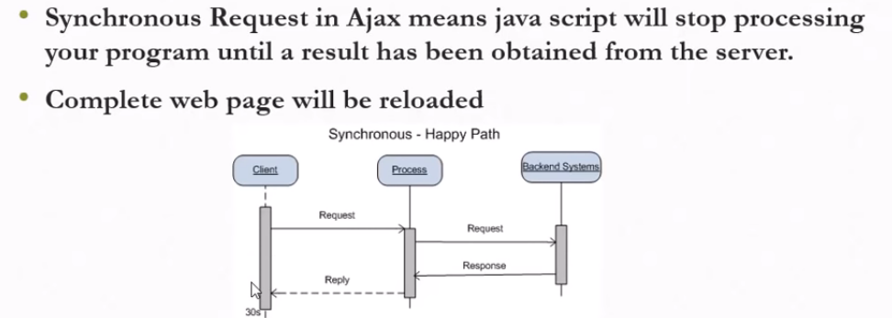
Synchronous request

Slide 9
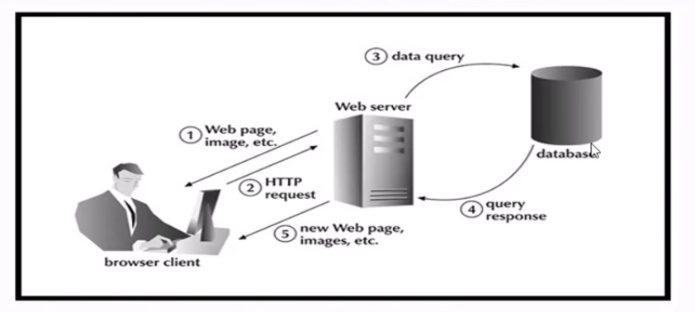
Synchronous request

Slide 10
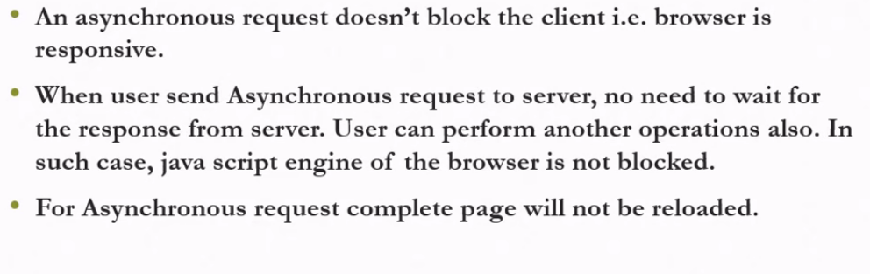
Asynchronous request

Slide 11
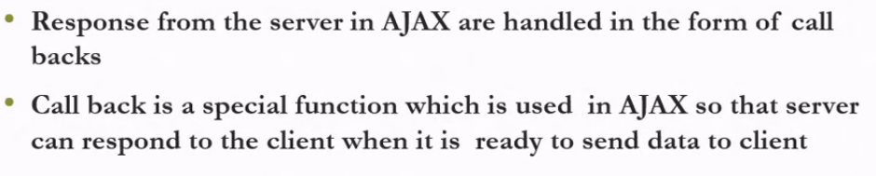
How response will be handled in Async request?

Slide 12
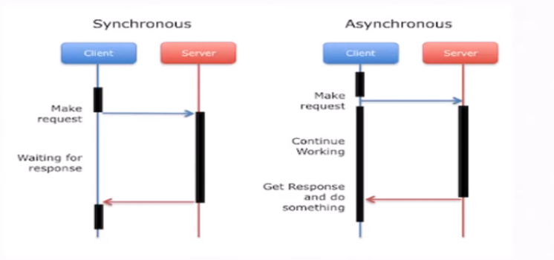
Sych vs Asynch

Slide 13
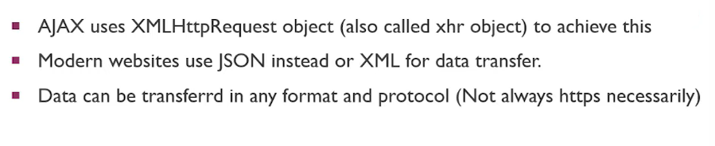
Ajax with xhr object

Slide 14
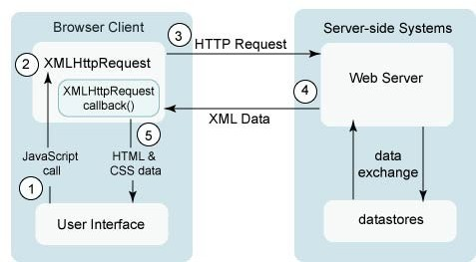
AJAX Request
Source: http://java.sun.com/javaee/javaserverfaces/ajax/tutorial.jsp

Slide 15
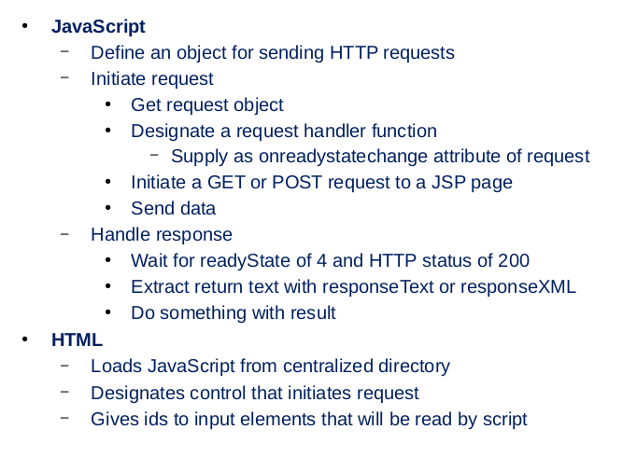
Ajax steps

Slide 16
Ajax hello world
var ajaxObject=null;
if (window.XMLHttpRequest)
ajaxObject=new XMLHttpRequest();
if(ajaxObject!=null){
/*Open an GET request for resource url asynch.*/ ajaxObject.open("GET",url,true); ajaxObject.send();
}
else{
alert("Not having suitable browser ...");
}
ajaxObject.onreadystatechange=function()
{
if(ajaxObject.readyState==4 && ajaxObject.status==200){
document.getElementById(id).innerHTML=ajaxObject.responseText;
}
};

Slide 17

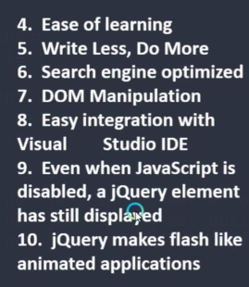
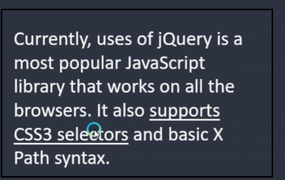
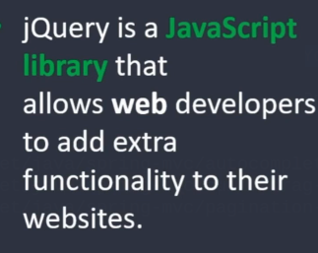
JQuery

Slide 18
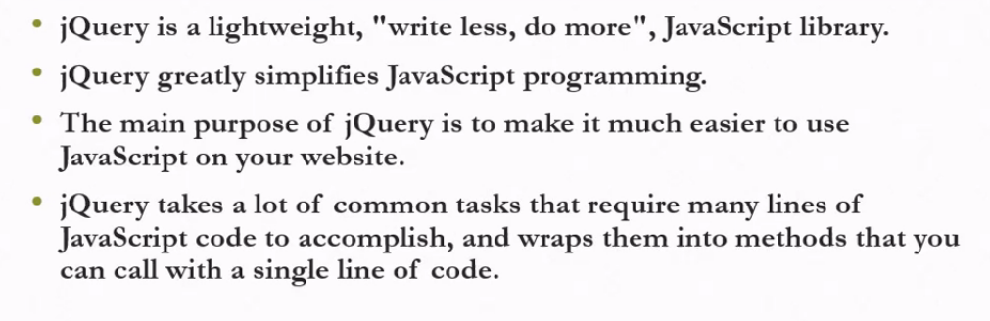
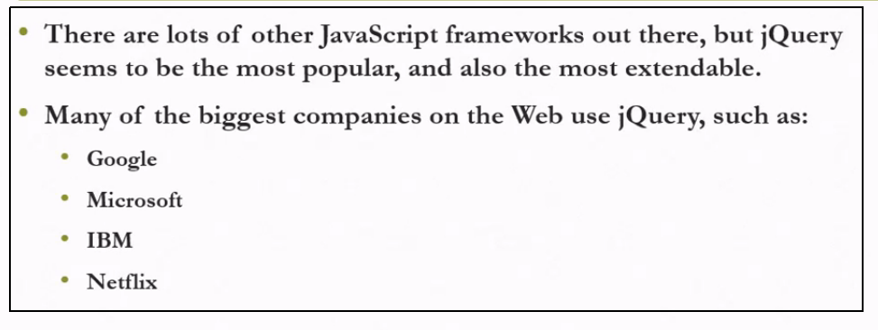
What is jQuery?

Slide 19
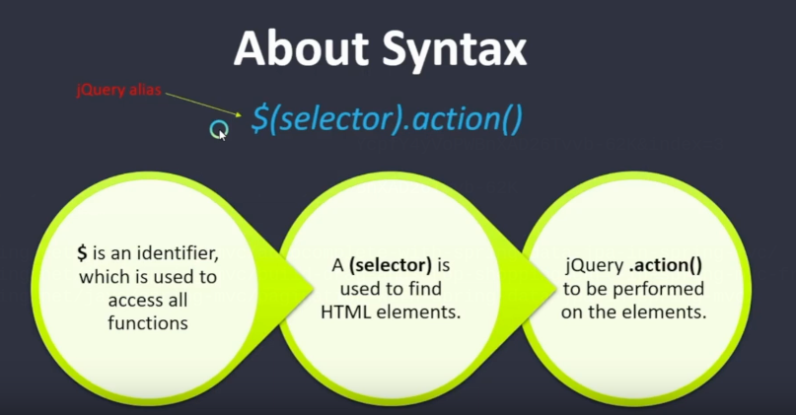
jQuery syntax

Slide 20
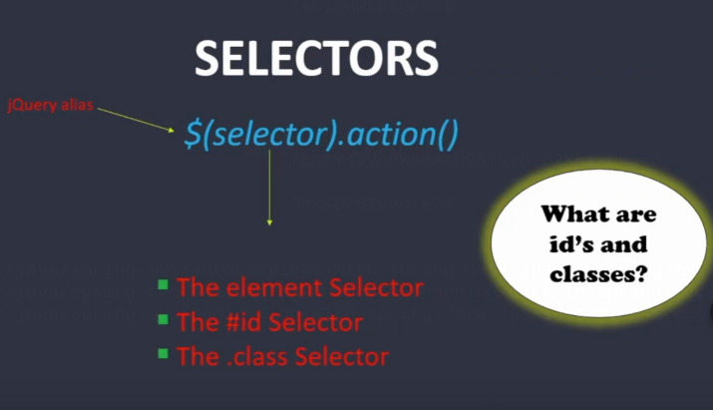
jQuery selectors

Slide 21
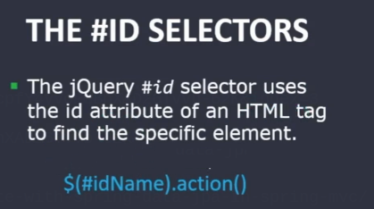
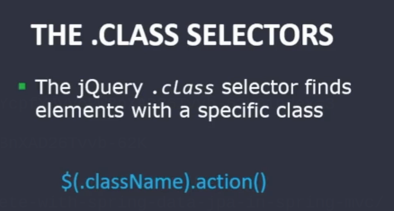
jQuery selectors

Slide 22
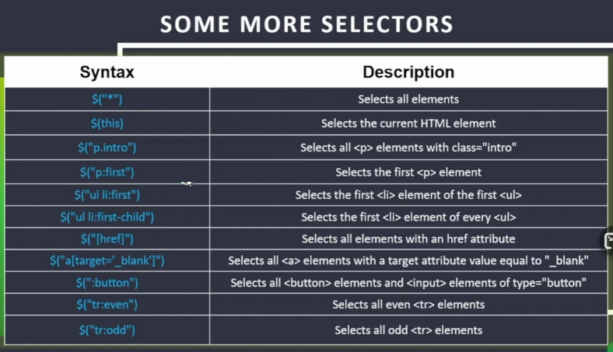
Some selectors

Slide 23
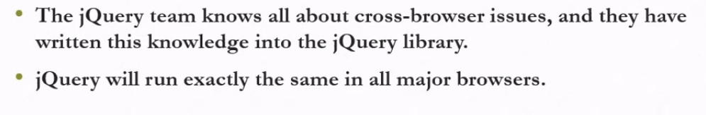
Will jQuery work with all browers?

Slide 24
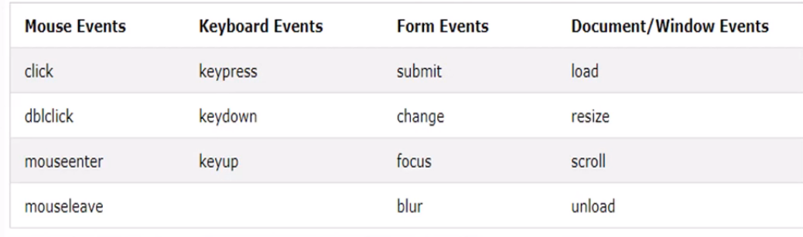
Common dom events

Slide 25
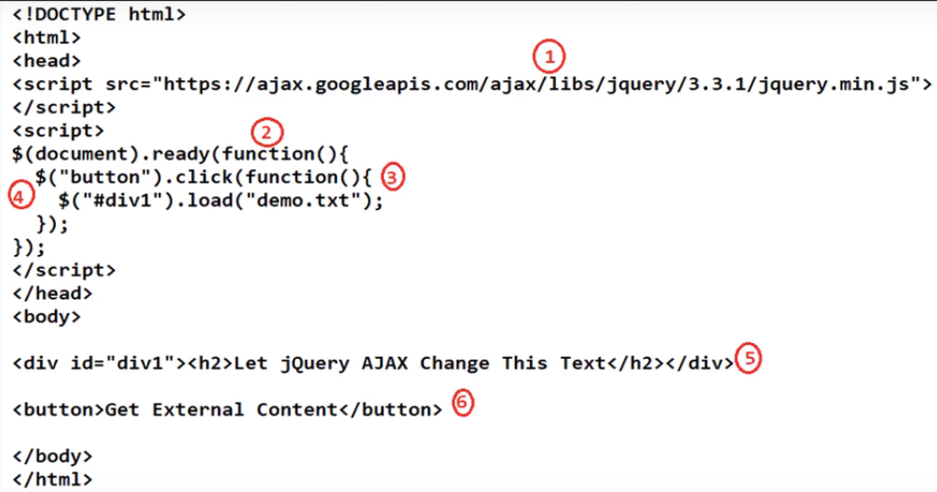

Slide 26
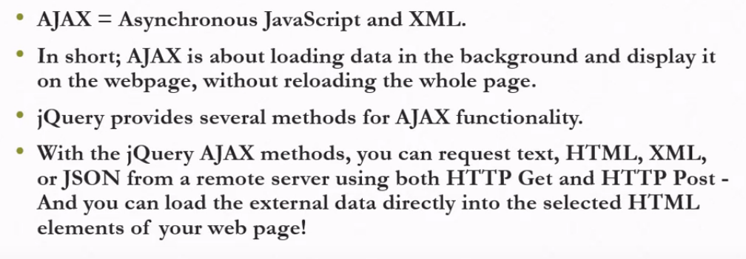
Ajax with jQuery

Slide 27
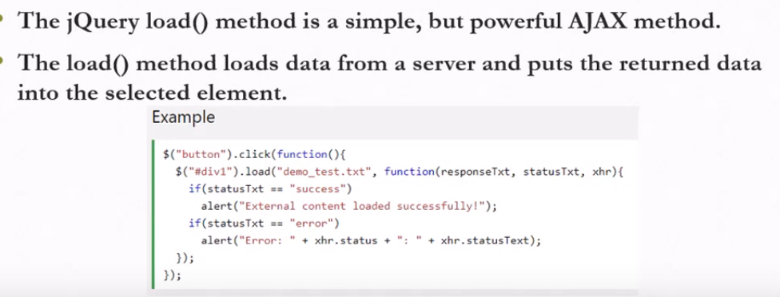
jQuery load method

Slide 28
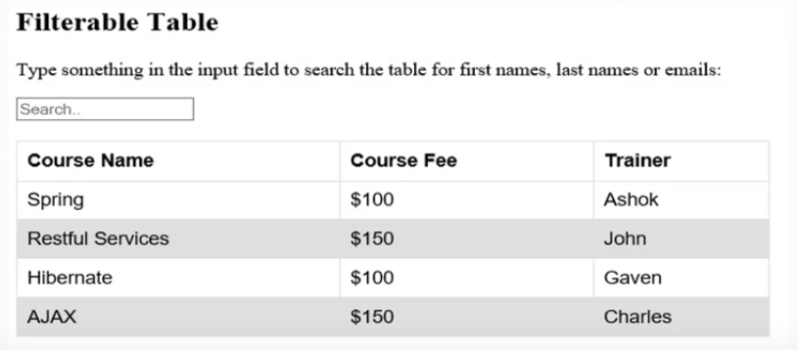
jQuery table filtering

Slide 29
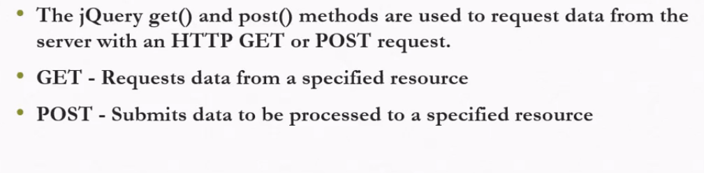
jQuery get and post method

Slide 30
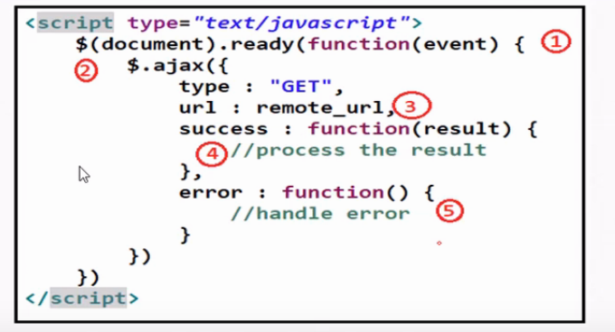
Ajax with jQuery

Slide 31
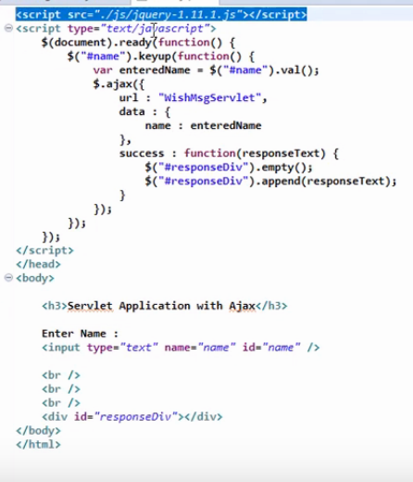

Slide 32
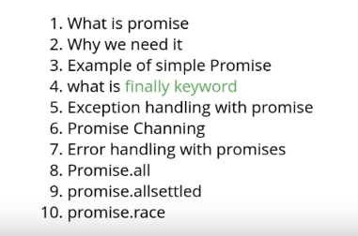
Ajax with promise

Slide 33
Ajax with promise

Slide 34
Ajax with promise

Slide 35
Ajax with promise

Slide 36
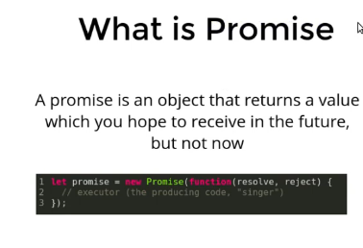
Ajax with promise

Slide 37
